Slide 1
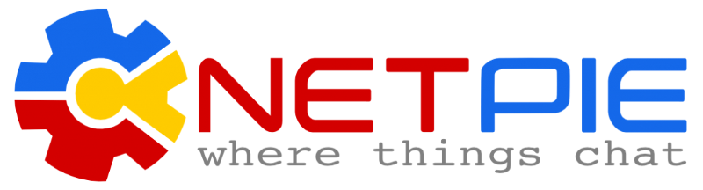
Part 2: NETPIE Introduction
(IoT Activity Kit)
by NETPIE.io
Customized and presented by Dr.Varodom Toochinda, Nov 2018, Last edited by Aimaschana Dec 2018

Slide 2
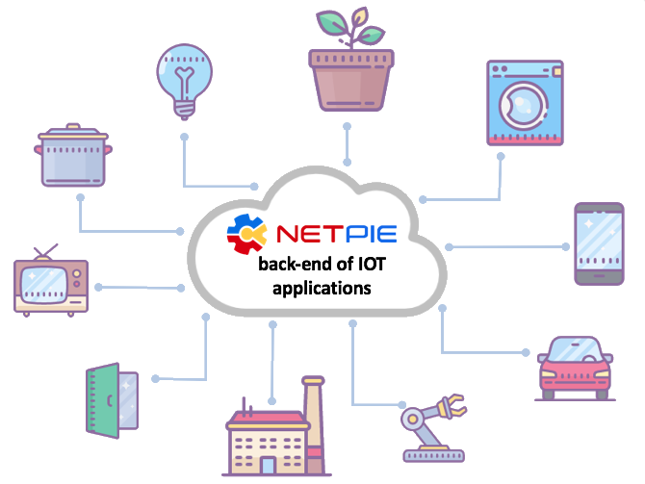
NETPIE is……
IoT Platform facilitating real-time communications between things.
Has cloud data storage
Has configurable, ready-to-use dashboard
Has open-source library
Supports various
rogramming languages

Slide 3
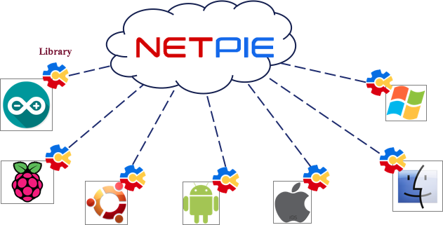
NETPIE คือ
From the perspective of developers,
NETPIE basically consists of
CLOUD + CLIENT LIBRARY

Slide 4
Client Library
Client library of NETPIE is called Microgear library
It has four main functions
✔ Authorization (รับรอง)
✔ Authentication (อนุญาต)
✔ Communication (สื่อสาร)
✔ Coordination (ประสาน)

Slide 5
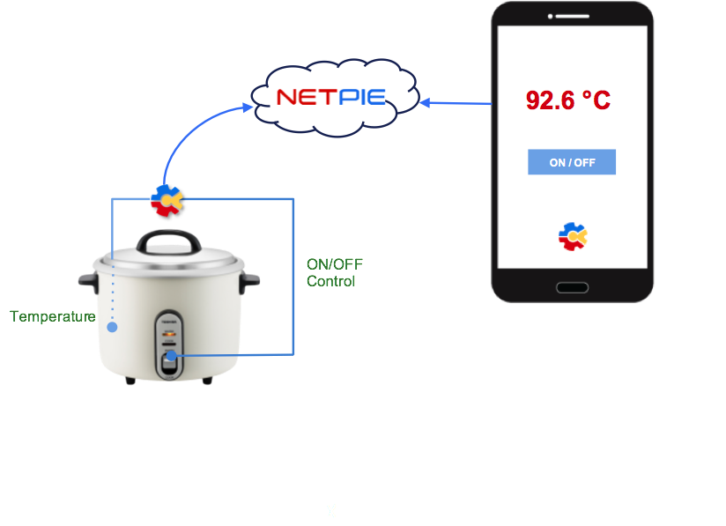
How it works

Slide 6
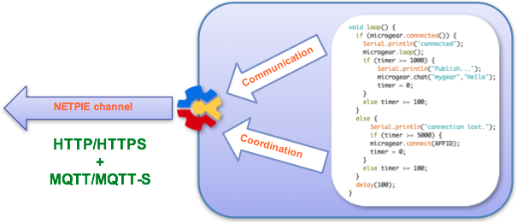
The mechanism inside….
Device authenticates with key+secret and gets access token.
Devices refer to each other with ALIAS.
Devices communicate via MQTT and HTTP protocols.
Microgear library acts as the middleware to NETPIE service.

Slide 7
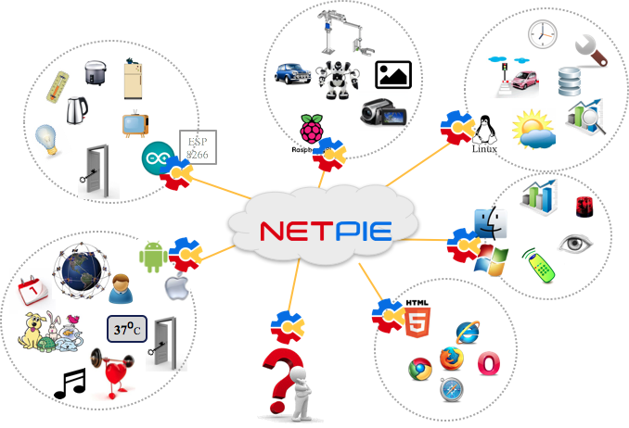
NETPIE - Where Things Chat
“Creativity is just designing
how THINGS connect.”

Slide 8
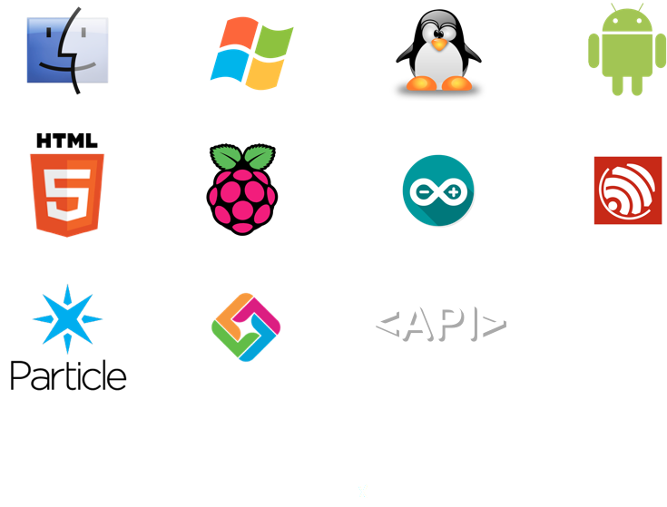
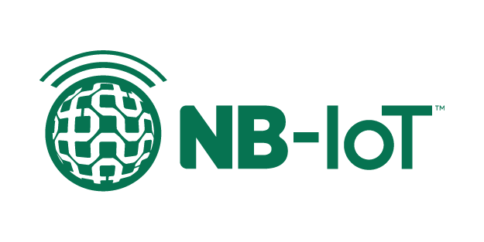
Supporting Hardware and OS

Slide 9
Supporting languages
C++(ESP8266, ESP32, Arduino, Particle)
Node.js
C#
Javascript
Android
Java
Node-red
Python

Slide 10
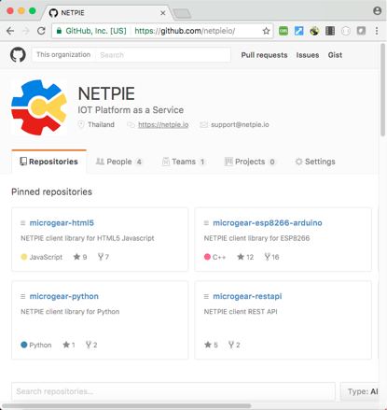
Open-source library
MQTT
https://github.com/netpieio
NodeJS
Python
HTML5 Javascript
Arduino
ESP8266 Arduino
Android Studio
C#
JAVA
RESTful API
More coming soon…
HTTP

Slide 11
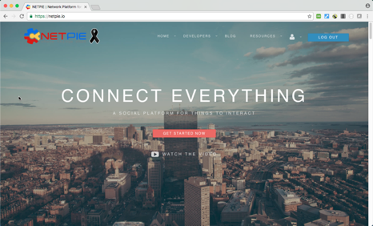
NETPIE.io
https://netpie.io
Free 100 credits with unlimited time !

Slide 12
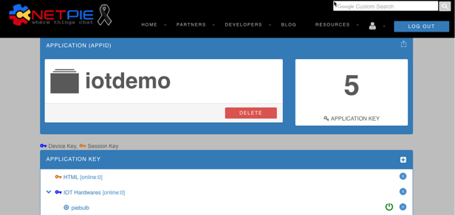
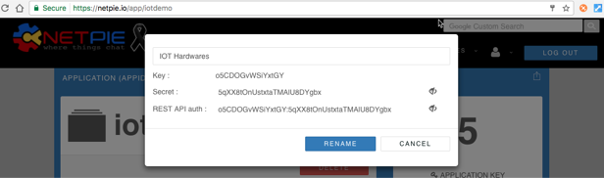
Application ID
APPID
Key,Secret

Slide 13

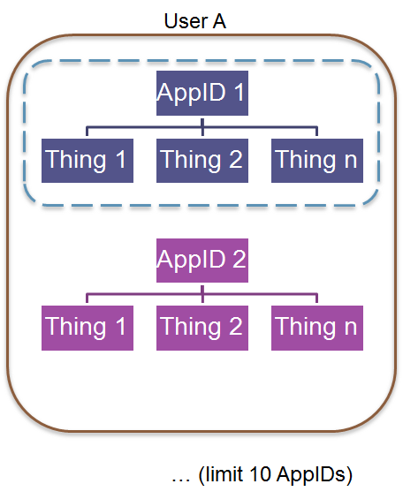
Application ID Defines Scope

Slide 14
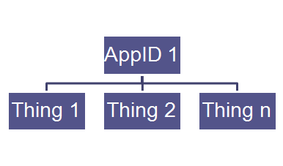
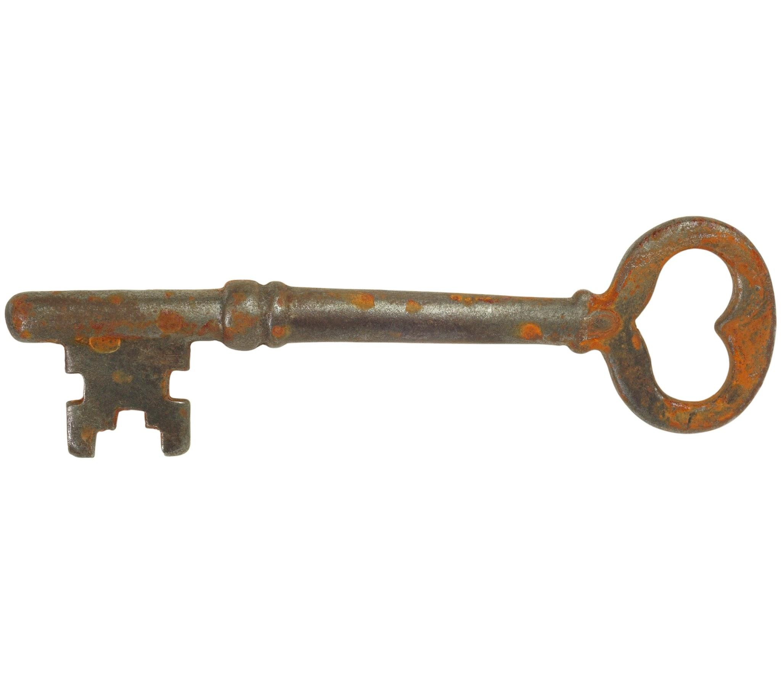
Key & Secret Are Credentials for Device Authentication
(Key, Secret) (Key, Secret) (Key, Secret)
Option 1: Share the same key for all devices

Slide 15
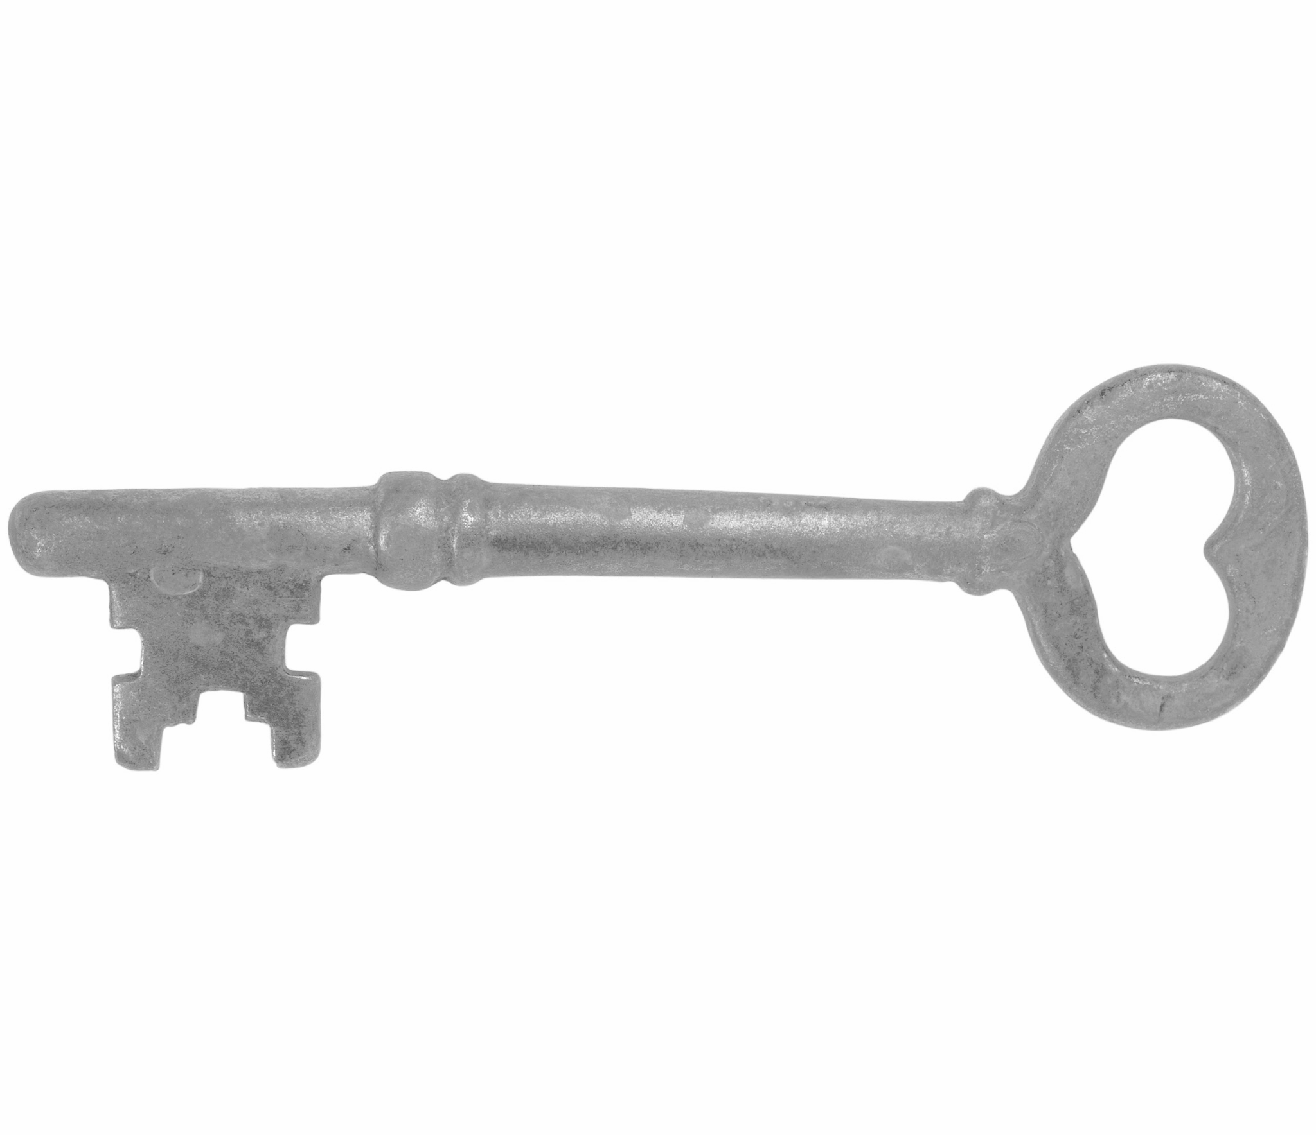
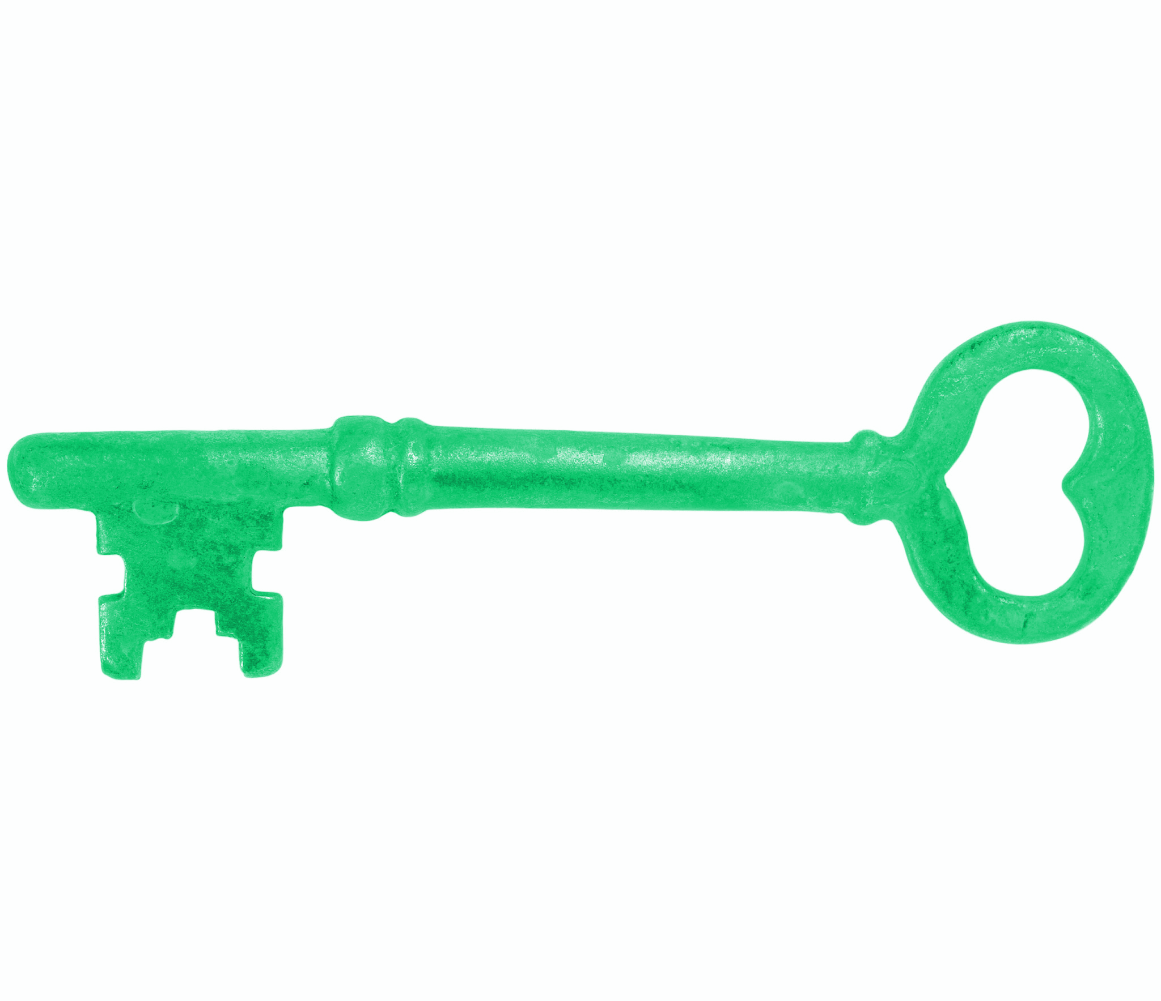
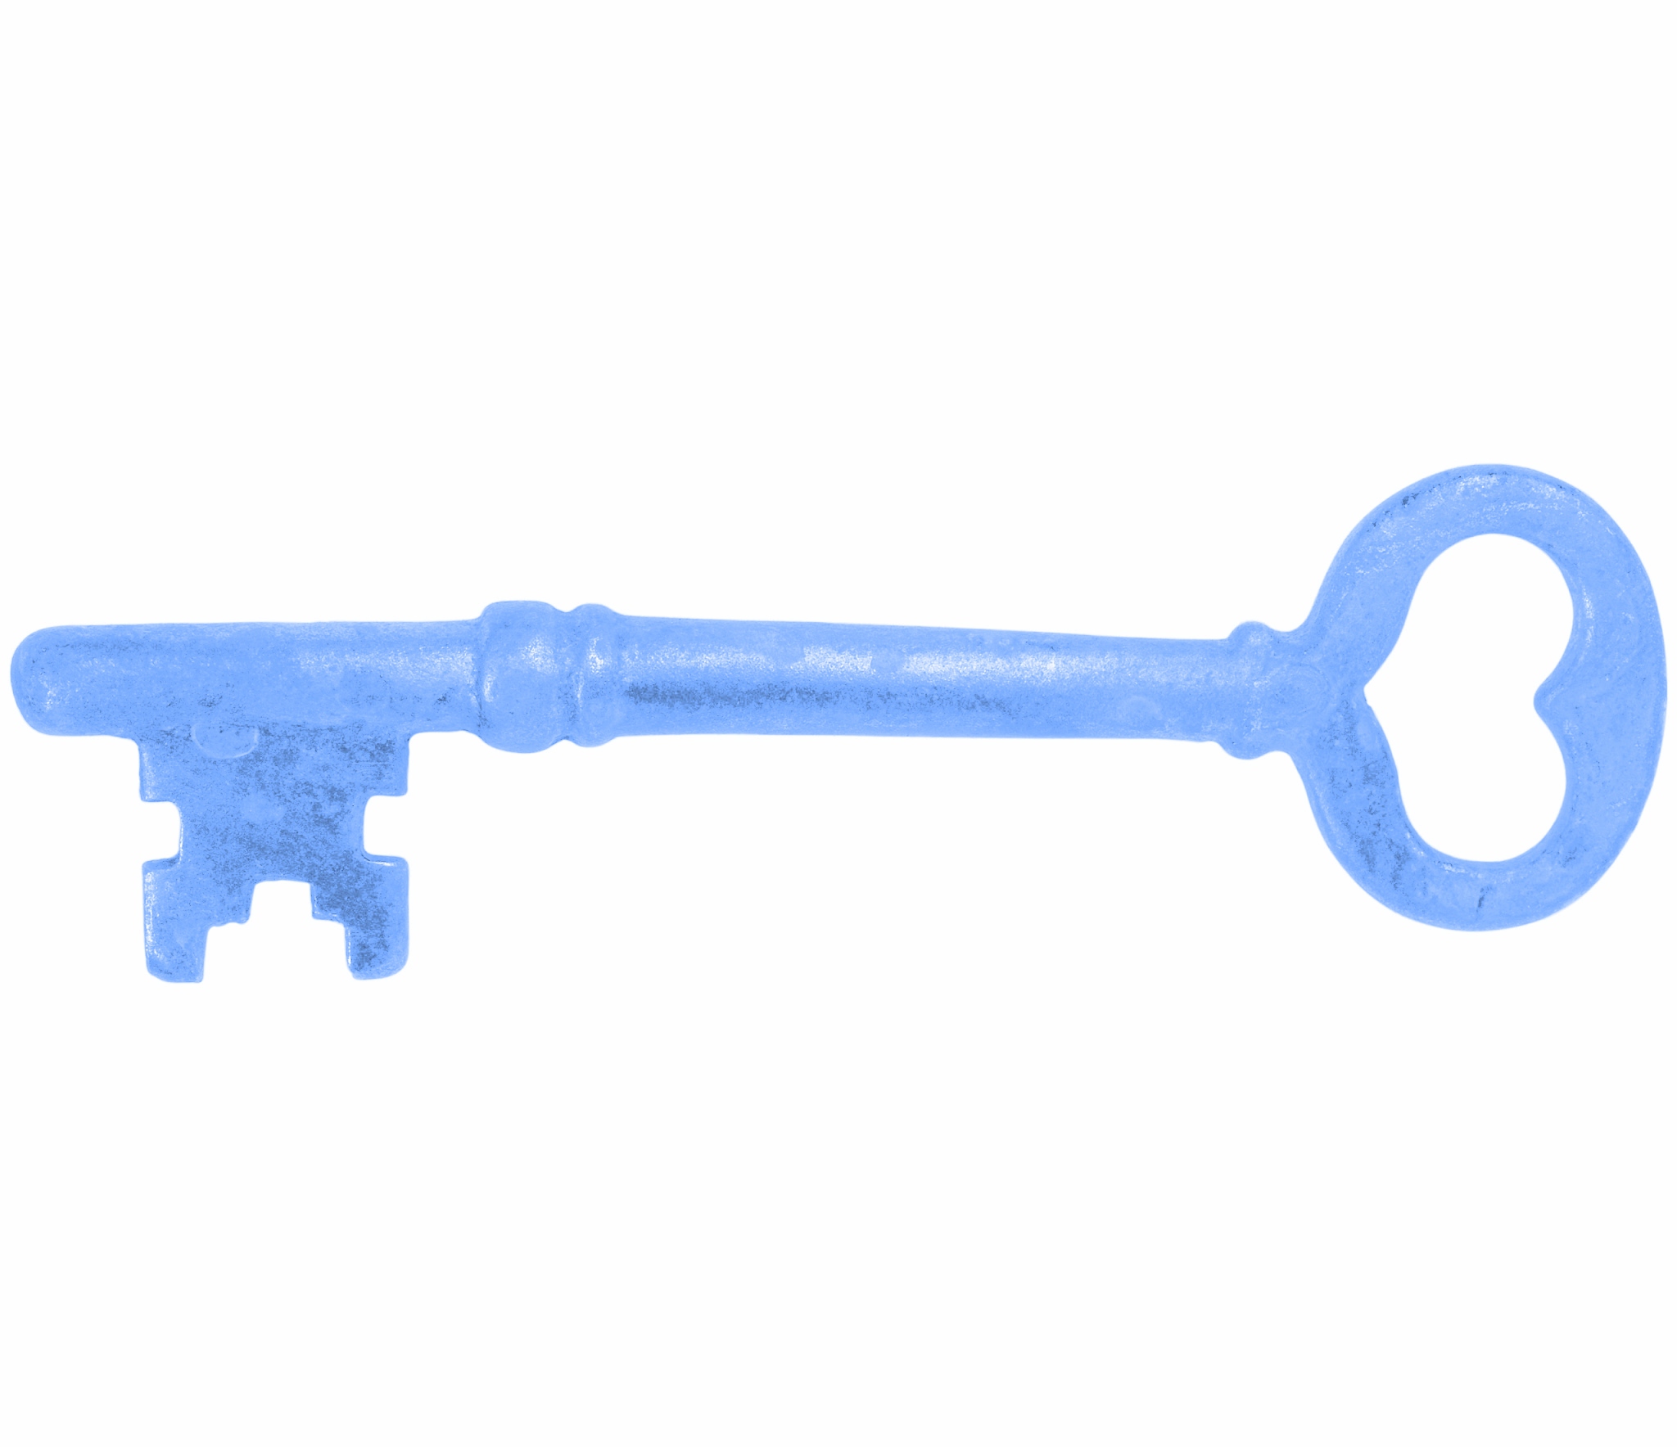
Key & Secret Are Credentials for Device Authentication
(Key1, Secret1) (Key2, Secret2) (KeyN, SecretN)
Option 2: Use different keys for different devices

Slide 16
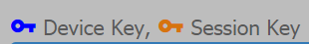
Key Types
Device Key
Device key generates permanent token(s).
Recommended for physical devices where identities are persistent.
Session Key
Session key generates one-time token(s).
Recommended for logical devices e.g. web browser
Once disconnected from NETPIE, one-time token will be revoked

Slide 17

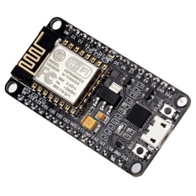
ALIAS
ALIAS = nickname for your NETPIE “things”
MyBulb
“MyBulb, please turn on”
“MyBulb, are you turned on?”
MyApp
“MyApp, now it is too dark”
MyBoard

Slide 18
NETPIE Resources
Application
Freeboard
Feed

Slide 19
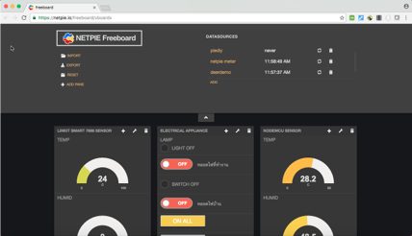
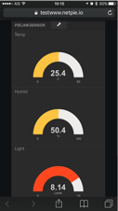
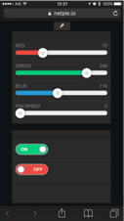
Hackable Open-source Dashboard
NETPIE Freeboard is open-source, configurable dashboard, in which
Datasource is retrieved and displayed in real time,
There are a variety of widgets for monitoring and controlling,
Web server is not required as it runs on client side.

Slide 20
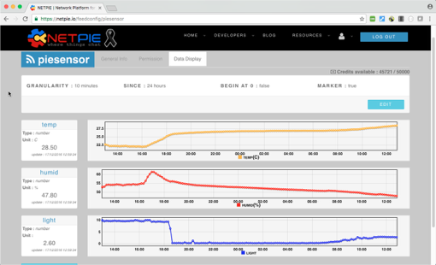
Data Storage Service
Feed
Stores time-series type of data
Up to 32 data fields per feed
Allowing up to 1 write per 15 seconds
Accessible through REST API

Slide 21
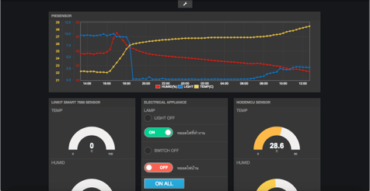
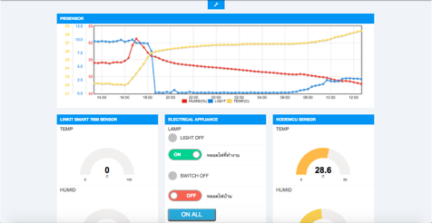
Data Widget
Feed View
Widget in the dashboard to show live feed
Support plotting multiple datasets on the same chart
Customizable colors and styles

Slide 22
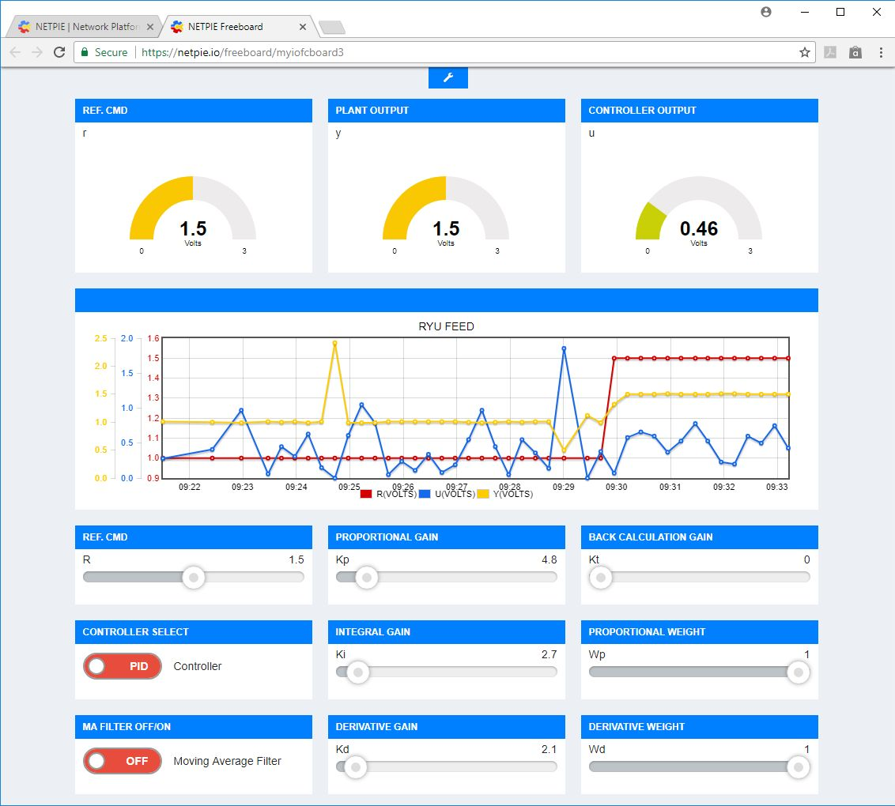
NETPIE Freeboard Example

Slide 23
Demo/Videos
Controlling RGB LED with 3 sliders on NETPIE Freeboard http://dewninjathai.blogspot.com/2017/07/freeboard-slider-esp8266-microgear.html
Reading from LSM9DS1 sensor (acceleration, angular rate and magnetic in 3D)
http://dewninjathai.blogspot.com/2018/04/lsm9ds1-netpie-freeboard.html

Slide 24
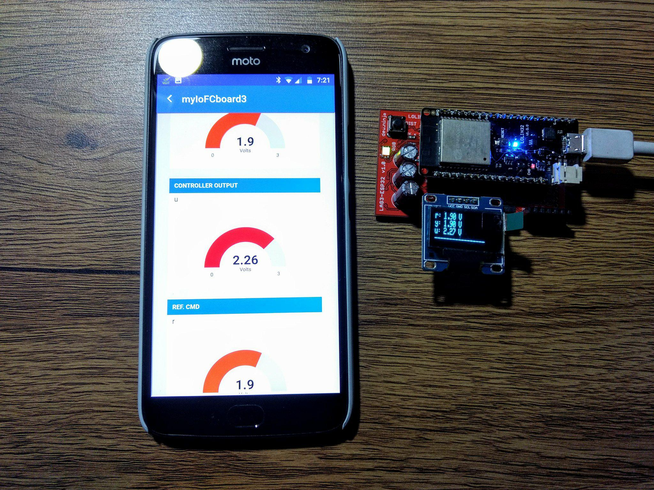
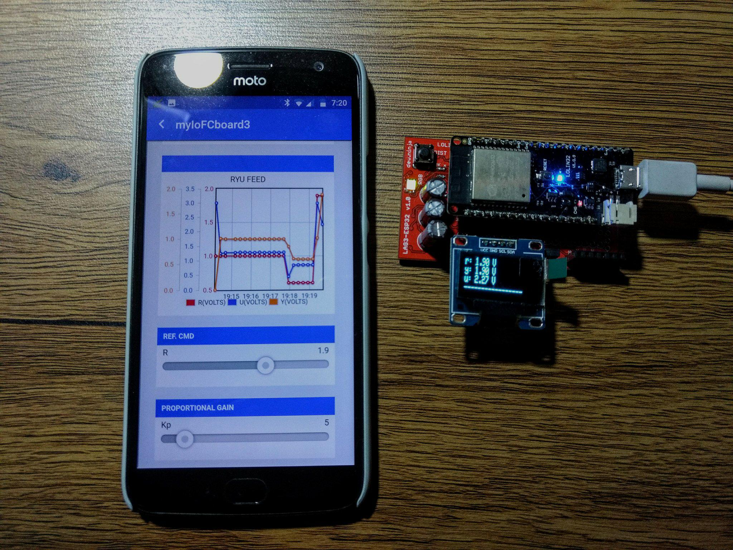
NETPIE Mobile App

Slide 25
Guide for how to install and use mobile app
Installation and instructions http://dewninjathai.blogspot.com/2018/04/netpie-app.html
Controlling robotic arm
http://dewninjathai.blogspot.com/2018/04/2-esp32-netpie.html
Testing push notification http://dewninjathai.blogspot.com/2018/05/push-notification-netpie-app.html

Slide 26
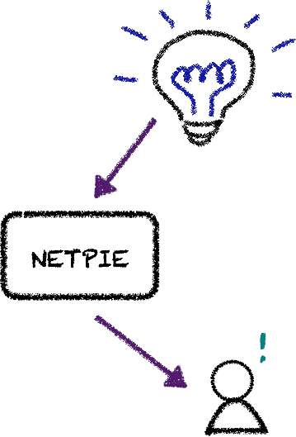
Presence API
Device Status API
API notifying status of device (Online/Offline)
Available for both REST API และ Microgear method

